Slide 1
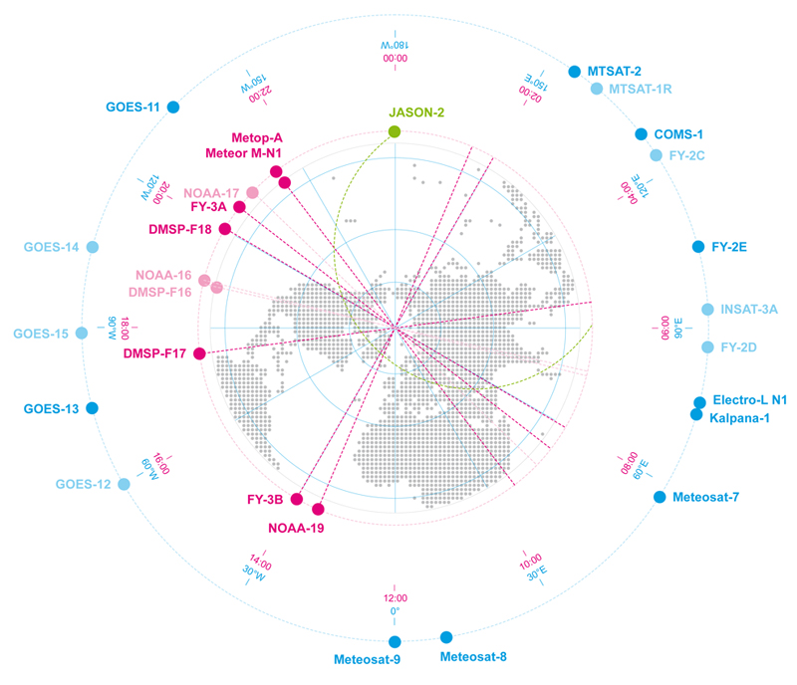
Current status of JMA’s satellite data on WIS Response to Action.3 identified at 1st telecon on 3 September 2014
Yoshito Yoshizaki
Hidehiko Murata
Yasushi Izumikawa
Japan Meteorological Agency

Slide 2
Action.3
Assess the presence of JMA satellite data in the GISC catalogue, provide a status on the metadata type (version, particular elements, ...) used.

Slide 3
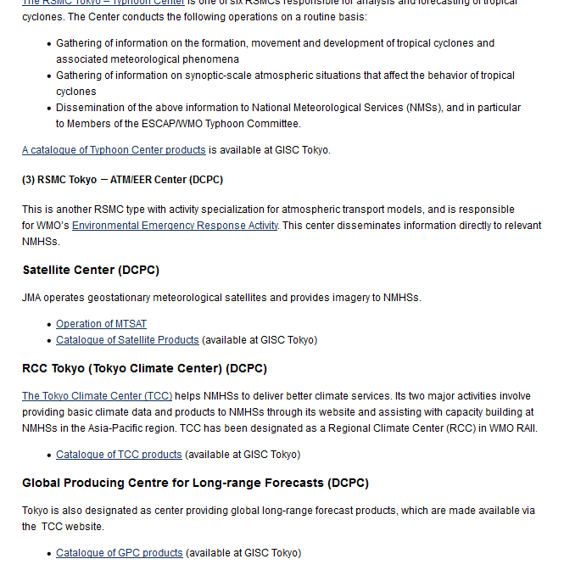
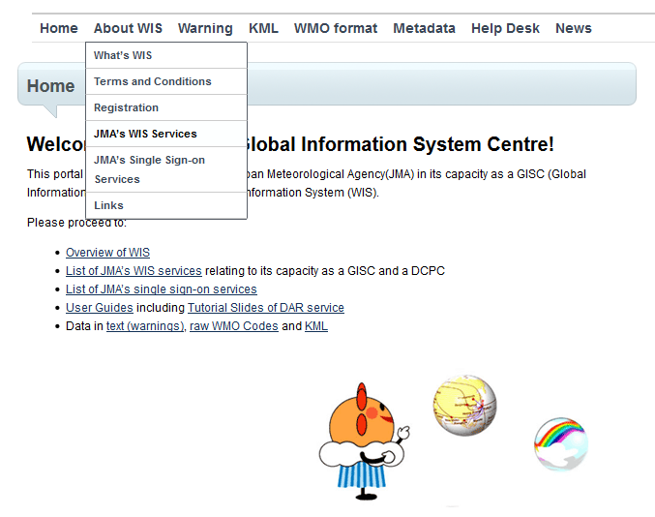
Coordination Group for Meteorological Satellites - CGMS
Search results on GISC Tokyo portal site -1-
From GISK Tokyo portal site home page, you can reach JMA’s WIS services page by clicking “About WIS”, “JMA’s WIS Services”.
Then you can find link of “Catalogue of Satellite Products”.

Slide 4
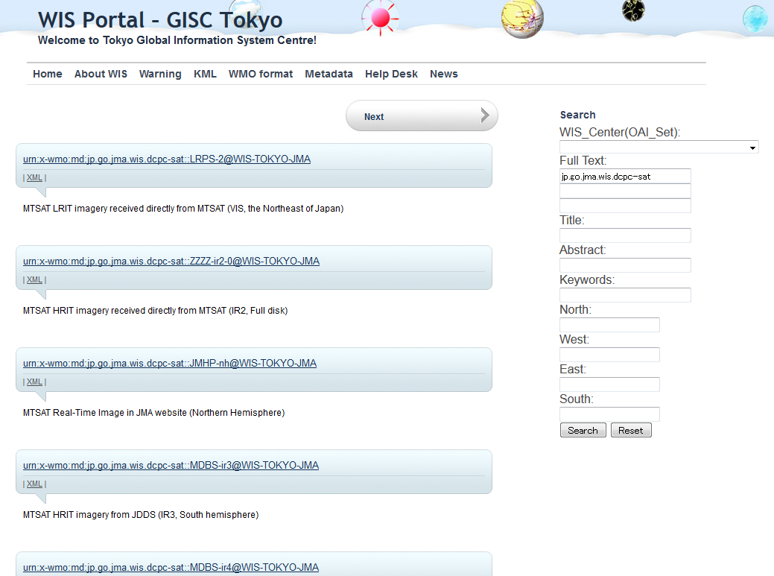
Coordination Group for Meteorological Satellites - CGMS
Search results on GISC Tokyo portal site -2-
You can reach 80 metadata of JMA satellite data catalogue within 8 pages.

Slide 5
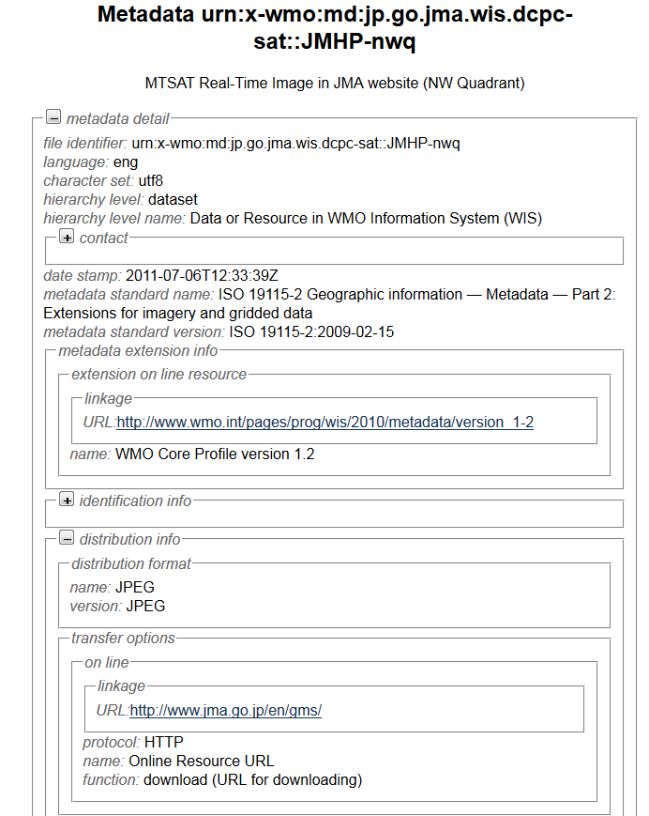
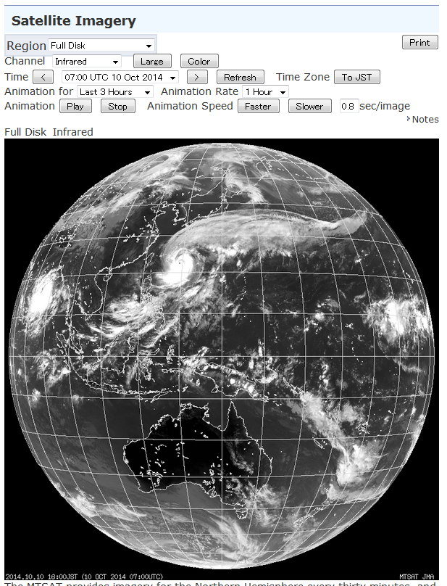
Search results on GISC Tokyo portal site -3-
If you click one of them, you can get metadata structure like below.
Most of them has the link to indicate how to reach the data and not the link for actual data itself, because originally most of them are not connected to open online access.
A few metadata such as “MTSAT Real-Time Image in JMA website” give direct link to actual data.

Slide 6
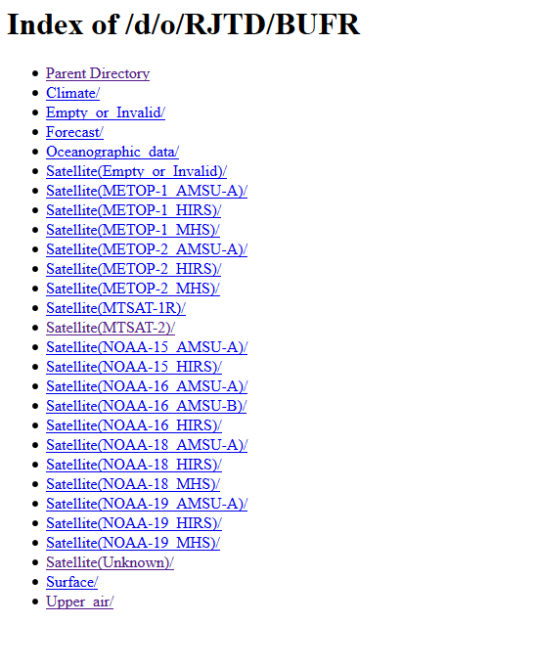
Coordination Group for Meteorological Satellites - CGMS
Other JMA satellite data on WIS -1-
In the GTS cache of GISC Tokyo, there are some JMA satellite products, such as AMVs and AP RARS (AMSU, HIRS) data.
Currently this page can be hardly found and metadata does not lead users to this page.
One of the point to be corrected in GISK Tokyo.

Slide 7
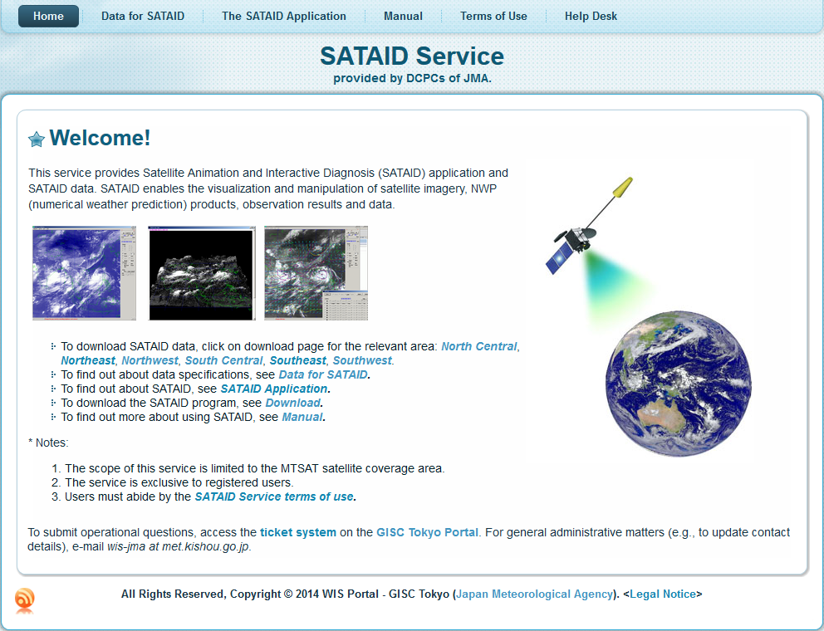
Coordination Group for Meteorological Satellites - CGMS
Other JMA satellite data on WIS -2-
Following satellite data are also distributed/disseminated as a part of WIS:
MTSAT direct dissemination
JMA Data Dissemination System (JDDS) for account users
SATAID service for account users

Slide 8
Coordination Group for Meteorological Satellites - CGMS
Analysis of metadata
Metadata version: ISO 19115-2, WMO Core Profile ver1.2
Currently several keywords were described randomly. It should be categorized properly.
There’s no orbit information nor sensor information.

Slide 9
Coordination Group for Meteorological Satellites - CGMS
Summary
JMA surely provides several satellite data and products on WIS.
But currently due to incompleteness of metadata and inadequacy of usability in GISC Tokyo, JMA satellite related data can be hardly found on WIS from user perspective.
Also many of JMA satellite metadata need to be updated especially for Himawari-8 related data.
JMA satellite metadata lacks information which are essential for satellite such as sensor or orbit.
This task force is good opportunity for JMA.

